Slide 1

The top 5 benefits of using the cloud for automatic enrolment
Learn how online payroll solutions can streamline the transition and solve complex automatic enrolment challenges for your business.

Slide 2

Background to automatic enrolment
Automatic enrolment, part of the government’s workplace pension reforms, is being introduced to combat the issue that people are living longer and healthier lives but are saving less for their retirement. As the ratio of workers to those of a pensionable age continues to fall, the government has estimated that as many as seven million people are currently not saving enough for an adequate retirement income.
As state pensions will be unable to bear the increasing numbers of retirees, The Pensions Act 2008 established new duties to redress this imbalance. Automatic enrolment as part of these changes, began to be rolled out amongst businesses in October 2012.
The changes brought about by the new legislation are complex and require early education and preparation to allow businesses to gain a full understanding of how to capitalise, adapt, and ensure compliance.
With 770,000 businesses staging during the 2015-2016 financial year, the numbers seeking support and advice about the legislative transition will increase considerably.
Legal information
This information doesn’t constitute financial, investment or professional advice and shouldn’t be relied on as such.
KashFlow do not make any personal recommendation or give advice to employers and their workers on how to make investment decisions. If you are seeking this kind of advice we would suggest speaking with a qualified financial adviser.
Call 0844 815 5779 or visit kashflow.com/autoenrolment to see how we can help you

Slide 3
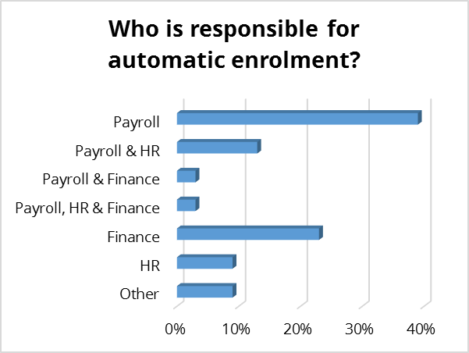
The cloud, payroll and
automatic enrolment
In recent years more businesses have begun catering to the “cloud”. Google Drive, the Apple iCloud and the ever increasing social networks like Facebook and Instagram all exist in the cloud.
The cloud itself, is another way of referring to online capabilities, programmes and storage. Online services, such as the ones mentioned above, offer increasing flexibility for people and businesses in the 21st century.
Now reaching much further than just online storage facilities, businesses are able to utilise solutions developed and expanded into the cloud confidently running integral parts of their businesses through these new and easily accessible means.
With ever increasing services provided online, many businesses are able to improve efficiency and productivity, whilst reducing costs and overheads.
Payroll and finance departments haven’t been left behind; the take up of online solutions for a range of businesses in this area has been positive and continues to rise.
In a recent KashFlow survey, 58% of respondents identified payroll as having primary responsibility for the management of automatic enrolment.
For efficient and successful automatic enrolment to be carried out, payroll holds a vital role with access to PAYE information and salary calculations at each pay period which must be evaluated prior to employee assessment.
Recognising the important role payroll has in automatic enrolment and the benefits of cloud solutions, some parts of the new legislation can be carried out using online enabled software.
Call 0844 815 5779 or visit kashflow.com/autoenrolment to see how we can help you

Slide 4
The top 5 benefits of using the cloud for automatic enrolment
Automatic enrolment is full of complexities, but new online software can help business to manage these changes in a number of ways.
Compliance confidence
Keeping up to date with the latest software releases can be difficult, especially when there is more than one computer or user to update within your business. As payroll and tax legislation is always being updated, waiting for disks in the post to arrive or downloading updates can take up valuable time for your workforce – late updates can be costly - automatic enrolment non-compliance fines can be up to £10,000 per day.
Whether using complete online solutions to help eradicate these challenges by updating your software automatically, or by choosing options that work with desktop payroll software to provide a complete end-to-end solution, you can relax in the knowledge that it will all be taken care of in the cloud.
2) Efficient communications
Communicating to your employees about automatic enrolment is legally required. Not only must you notify all eligible employees prior to your staging date, communications must be sent out as new employees or current employees become eligible. This is an ongoing process.
Online solutions can help ease the pressures of sending legal communications, by dispatching these notifications directly to the recipient via the cloud at the touch of a button.
Dramatically reducing printing and postage costs, the cloud will not only help you stay green, but also help minimise those overheads.
3) Increased security
As more and more data is captured and stored online, cloud solutions are able to offer much more rigorous security that is able to respond quickly to ever-changing capabilities online.
Security levels offered by many business solutions in the cloud can provide customers with high level protection which is paramount to an organisation’s operations.
Call 0844 815 5779 or visit kashflow.com/autoenrolment to see how we can help you

Slide 5

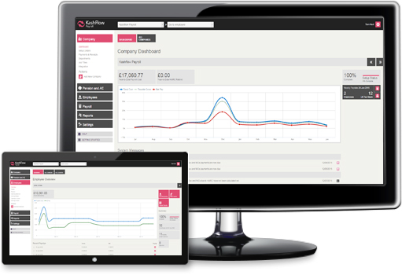
The top 5 benefits of using the cloud for automatic enrolment
4) Mobile access 24/7
Mobile devices and apps have risen in popularity over the last few years, and it’s a trend that appears to continue to climb with no signs of stopping. With more people gaining access to smartphones with app capabilities and add-ons, business and data management has become easier for everyone, not just the average office worker.
Accessing information via specific apps on a phone, from legitimate sources allows a worker to interact more efficiently and easily with company resources. The cloud is a vital component of app uptake and usage, and many businesses can help engage more effectively and directly with their workforce, by publishing payslips straight to an app profile, for example.
5) Flexibility for your workforce
As all businesses are required to prepare for eligible employees, this will mean a huge variety of organisations will have to consider the best way to move forward with automatic enrolment roll outs for their company.
Not only are businesses different to each other, workforces could comprise of multiple job roles and styles. For example, field representatives for a business may only visit their office location once a month.
Just as cloud solutions have offered great opportunities for people to maintain connections with friends and family around the world whilst travelling, utilising online solutions from businesses is a great way to streamline communications from company to employee.
Call 0844 815 5779 or visit kashflow.com/autoenrolment to see how we can help you

Slide 6

What are my automatic enrolment choices… software versus middleware?
The complexities of automatic enrolment are well documented and the costs associated with finding a solution to carry out all the required tasks have been debated. Businesses looking to minimise costs by employing middleware and manual solutions risk leaving themselves open to non-compliance and delays in submissions.
With the frequency of assessments, the volume of communications and changing work status for employees, both eligible and non-eligible, payroll teams and finance departments can find themselves stretched and left with limited time to focus on business priorities.
Having a variety of companies, with multiple solutions, completing different tasks makes auditing your automatic enrolment process difficult and expensive.
Payroll providers can offer fully compliant and complete automatic enrolment solutions. Using multiple 3rd parties to complete your solution can increase the risk of non-compliance due to the opportunity for multiple points of failure.
You may also be paying numerous license fees per employee for each solution you employ. A single source solution will eliminate the multiple charges, leaving you with a clear understanding of how much your solution costs. Also, with such a disjointed solution, the likelihood of additional manual processing is to be expected, adding further strain on your company and internal resources.
The benefits of having a whole software solution offered by one source can actually minimise your business’ overall costs, and allows you to complete the tasks required to achieve automatic enrolment compliance.
Although set up costs in the first instance may seem high, the long term benefits of a complete solution can not only save your company money but also time and employee resources.
Call 0844 815 5779 or visit kashflow.com/autoenrolment to see how we can help you

