Slide 1

4 key questions that reveal if you will miss your staging date
Find out if your business is at risk of missing its automatic enrolment staging date and the implications of doing this.
YOUR LOGO
HERE

Slide 2

Background to automatic enrolment
Automatic enrolment, part of the government’s workplace pension reforms, is being introduced to combat the issue that people are living longer and healthier lives but are saving less for their retirement. As the ratio of workers to those of a pensionable age continues to fall, the government has estimated that as many as seven million people are currently not saving enough for an adequate retirement income.
As state pensions will be unable to bear the increasing numbers of retirees, The Pensions Act 2008 established new duties to redress this imbalance. Automatic enrolment as part of these changes, began to be rolled out amongst businesses in October 2012.
The changes brought about by the new legislation are complex and require early education and preparation to allow businesses to gain a full understanding of how to capitalise, adapt, and ensure compliance.
With 32,000 businesses staging during the 2014-2015 financial year, the numbers seeking support and advice about the legislative transition will increase considerably.
Legal information
This information doesn’t constitute financial, investment or professional advice and shouldn’t be relied on as such.
KashFlow do not make any personal recommendation or give advice to employers and their workers on how to make investment decisions. If you are seeking this kind of advice we would suggest speaking with a qualified financial adviser.
YOUR LOGO
HERE

Slide 3

How is your staging date calculated?
Your staging date is based on the PAYE data provided to The Pensions Regulator (TPR) by HMRC on 1st April 2012 – employers will then be contacted by TPR 12-18 months before their staging date and then again 3 months before their staging date
Your PAYE count is not necessarily equal to your number of employees
You may have an earlier staging date if you have at least one person paid under a PAYE scheme larger than the employer’s “main PAYE” (e.g. parent company’s PAYE reference).
Table of staging dates
No of staff in largest PAYE | Staging Date
160 - 249 | 1st April 2014
90 - 159 | 1st May 2014
62 - 89 | 1st July 2014
61 | 1st August 2014
60 | 1st October 2014
59 | 1st November 2014
58 | 1st January 2015
54-57 | 1st March 2015
50 – 53 | 1st April 2015
40 - 49 | 1st August 2015
30 – 39 | 1st October 2015
Fewer than 30 | 1st June 2015 – 1st April 2017
YOUR LOGO
HERE

Slide 4

The implications of missing your staging date
A recent report by Hargreaves Lansdown has shown that as many as 8,000 companies who should have staged for automatic enrolment may not have done so. Around 23,000 businesses were due to have staged by the end of May 2014, however the number of employers who had confirmed details of their auto enrolment pension scheme was just over 15,000.
This backs up findings from pension providers such as NEST, NOW and Standard Life who are not seeing the volume of new schemes they would have expected.
Penalties for non-compliance
Warning
If you are not ready to meet the new legislation in time for your staging date, The Pensions Regulator will issue a compliance notice.
Fixed fine
If the employer doesn’t comply after the initial warning The Pensions Regulator will give another
warning and a fine of £400.
Daily fine
Where the employer continues to break the regulations, there will be a fine for each day with the penalty increasing until the company complies. The daily fine will depend on the number of employees.
Number of employees | Daily Fine
500 + | £10,000
250 - 499 | £5,000
50 - 249 | £2,500
5 - 49 | £500
1 - 4 | £50
YOUR LOGO
HERE

Slide 5

The 4 key questions that reveal if you are at risk
1. Do you know what your staging date is?
It may sound obvious but recent findings by The Pension Regulator has shown that 47% of small employers do not know this. The Pension Regulator will write to all companies with details of their staging date but it is possible that this letter could get lost in the post or go to the wrong person within your business.
If you don’t know your staging date then how will you know if you will be ready in time?
The table shown in Page 3 is a good starting point to see when your staging date is likely to be based on the size of your business. However you should check your staging date ASAP on The Pension Regulator website as it may be earlier than you think.
Click here to find out your staging date
2. Have you started to put a plan together?
Industry experts all recommend preparing at least 12 months before your staging date.
This will allow you to find a suitable pension scheme for your business and work out how you are going to handle key tasks such as assessing your workforce and sending communications.
Nominate who within your business will be responsible for particular actions and ensure everyone is aware of their responsibilities. Ensure you allow for supplier lead time and in-house resources you may need such as IT support.
YOUR LOGO
HERE

Slide 6


The 4 key questions that reveal if you are at risk (continued)
3. Do you know the difference between an eligible jobholder and an entitled worker?
If not then you really do need to learn the legislation behind automatic enrolment. Different actions need to be taken for different types of workers and this can depend on age and earnings.
You’ll also need to know which pension schemes
qualify for automatic enrolment and your legal
obligations regarding opt-ins and opt-outs.
Knowledge is power and you will feel much more able to tackle automatic enrolment when you know what you need to do.
4. Have you ensured your software is up-to-date?
Dunelm Soft Furnishings hit the headlines for all the wrong reasons when they missed their staging date and failed to make pension payments for employees. To avoid their mistake it is vital to ensure you have compliant software in place that will correctly manage the auto enrolment processes.
Automating tasks will be key to ensuring you meet your deadlines.
Make sure you allow plenty of time for
ensuring your software is set-up-correctly
and you have any additional modules you
may need. Don’t forget to allow time for
training (lead times are likely to get longer
as the number of companies staging increases.
.
YOUR LOGO
HERE

Slide 7
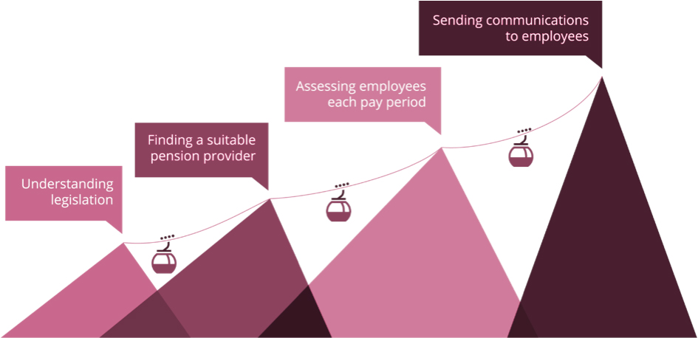
What you can do to
prepare now?
The following diagram shows you the key steps that you will need to complete to be ready in time for your staging date:
Understand what you need to do and when
Understanding the legislation is the recommended first step as everything else will flow from this. Once you know exactly what is required you can make sure you have a suitable pension provider (that is qualified by The Pension Regulator) and put your plan in place. Be proactive rather than reactive.
Talk to the experts
Feeling like you have to do everything yourself can be daunting and may lead to you putting things off. Talk to your payroll provider to understand what tasks can be automated and the help they can give you. You will feel better when you talk to people who understand exactly what you need to do and can give you the required support.
YOUR LOGO
HERE

